Slide 1


Hi!ckathon
HICRON
VISION ARCHITECT
SOLUTION MAKER

Slide 2



AGENDA
About Us
Meet Hicron
Rules of the Hackathon
Problems and Solutions

Slide 3

ABOUT US
Hicron is a Polish IT integrator and SAP Partner, and we are implementing, integrating, or servicing SAP Solutions, delivering world-class code in DevOps, Cloud Services, Digital Product Design, Software Development, and many more!
As a Vision Architect and Solution Maker, we are delivering top level solutions tailored to meet the needs of our clients. Our team consists of more than 300 experts in IT consulting, software development, quality assurance, IT process, and project management.
SAP SOLUTIONS
SOFTWARE DEVELOPMENT
E-COMMERCE SOLUTIONS
ATLASSIAN SOLUTIONS
BUSINESS AREAS
3

Slide 4
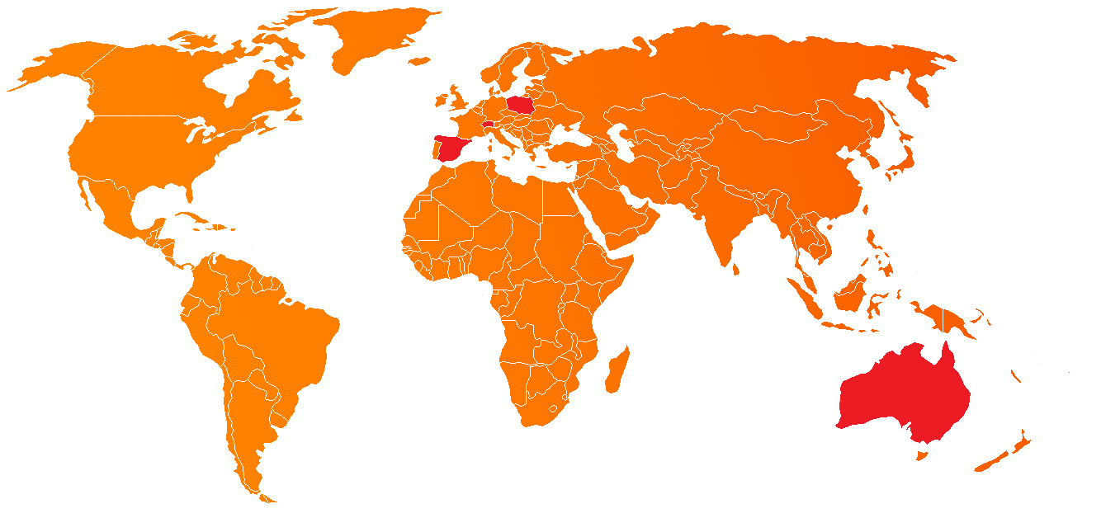
OUR OFFICES
WORLDWIDE
Poland
Switzerland
Spain
Australia

Slide 5

OUR OFFICES
IN POLAND
Poznań
Warsaw
Wrocław

Slide 6
SAY HI!CRON
HICRON SOFTWARE HOUSE
Notes:
Development and maintenance of custom software based on client requirements. The usage of programming languages and libraries for creation of new computer software.

Slide 7












OUR SERVICES
UX/UI SERVICES
SOFTWARE DEVELOPMENT
CLOUD MIGRATION
DEVOPS SERVICES
QA & TESTING SERVICES
AGILE COACHING
& TRANSFORMATION
POC / PROTOTYPING
LEGACY UPDATE
CLOUD NATIVE APPLICATION SERVICES
PRODUCT DEVELOPMENT SERVICES
APP MAINTENANCE – EVOLUTIONARY DEVELOPMENT
PREMIUM NEARSHORING

Slide 8













We are experts in C#, .NET, Azure and Microsoft ecosystem. Yet Java, Angular or other cloud solutions are no strangers to us.
OUR TECHNOLOGIES
8

Slide 9




MAIN AREAS OF FOCUS
BUSINESS
TRANSFORMATION
DIGITAL
TRANSFORMATION
APPLICATION
SERVICE & SUPPORT
CUSTOM SOFTWARE
DEVELOPMENT & CLOUD SERVICES
Driving the change
for our clients
by transforming their systems, processes, people, and technology.
Assisting our clients
in adopting innovative technologies to improve efficiency, value,
and innovations.
Implementing and supporting systems
for our clients.
We introduce the best DevOps practices.
Developing and innovating using the latest technologies for our client to meet their needs.

Slide 10

HICRON CUSTOMERS
10

Slide 11























SAP
HSH
TRUST
CONFIRMED BY
CUSTOMERS
11

Slide 12

HOW IS TO WORK WITH US?
You will work on big international projects with big international clients
Multicultural environment
English is the main language, you can improve it everyday!
You will be able to visit our different offices!
You can grow without limits!
DO YOU WANT TO KNOW MORE?

Slide 13
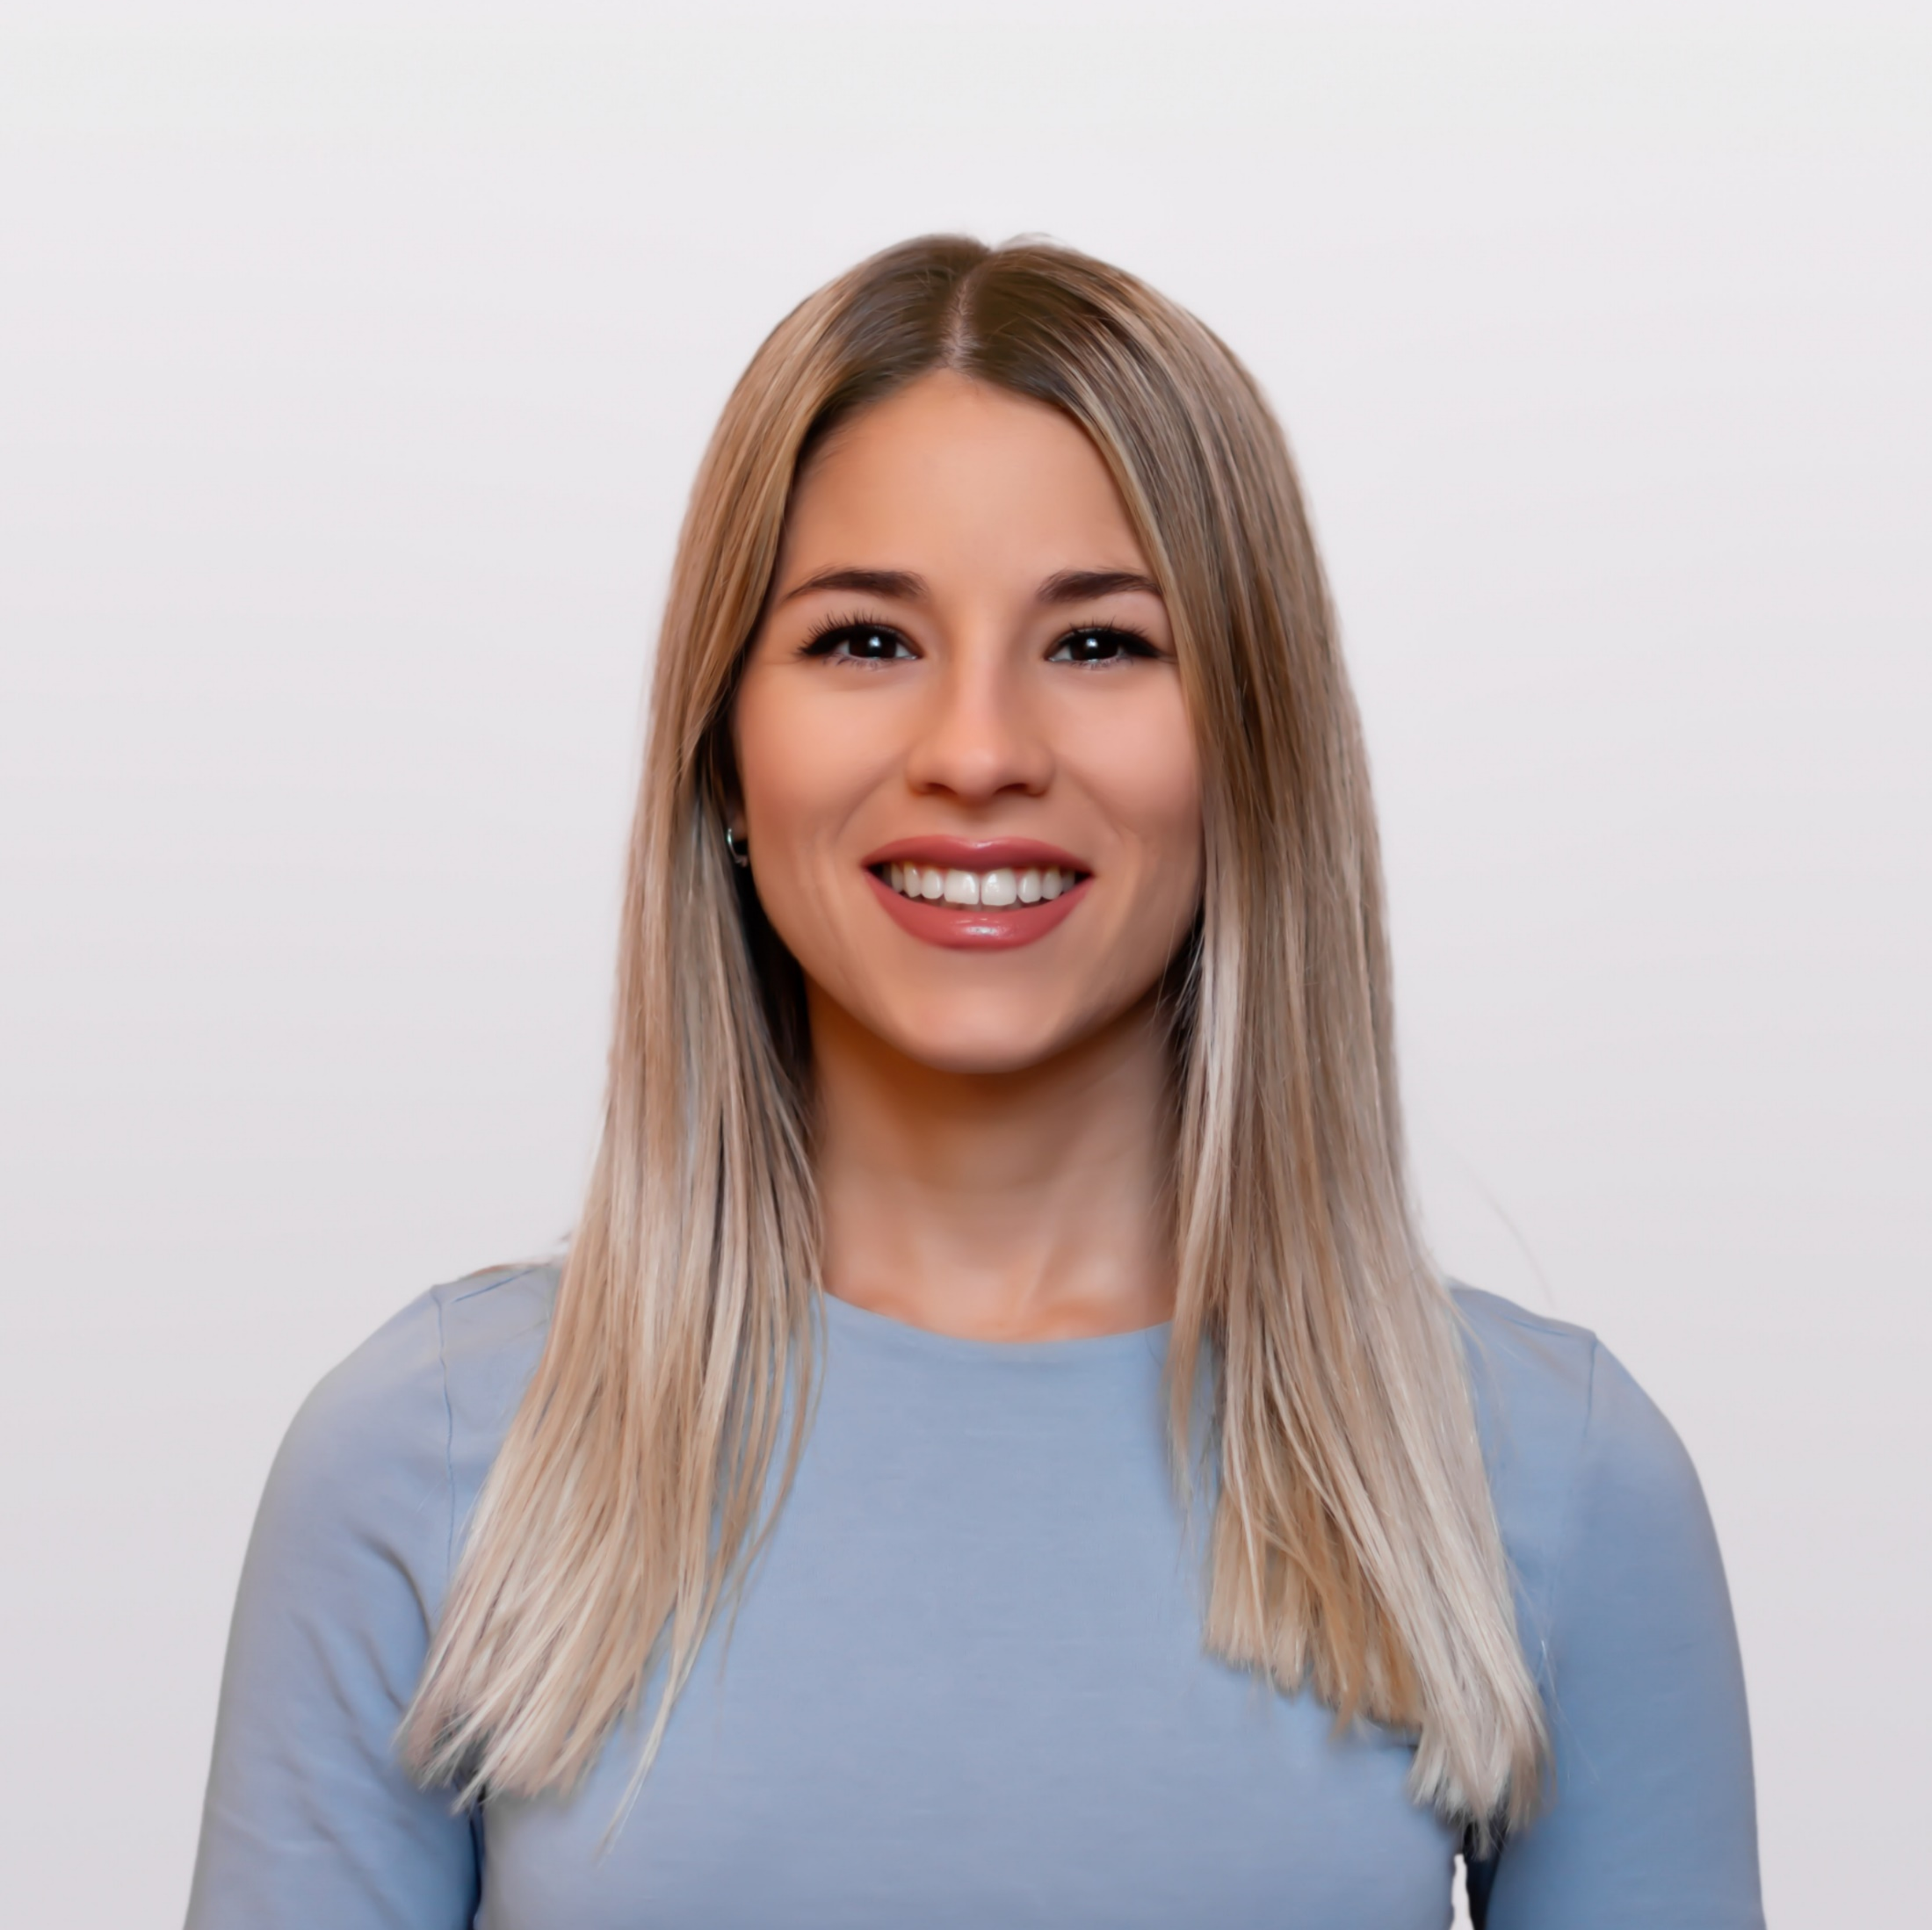
Estefanía Rodríguez Sánchez
Send us your CV!
Talent Acquisition Specialist
E.
Estefania.rodriguez@hicron.com
spain@hicron.com

Slide 14
(WELL, HI!CKATHON)
RULES OF THE HACKATHON
Notes:
Development and maintenance of custom software based on client requirements. The usage of programming languages and libraries for creation of new computer software.

Slide 15




English language
English is the main language for the event. You can ask technical questions in Spanish but we encourage you to make an effort and speak English like we do in our day-to-day job.
Individual projects
You will work on individual projects. You can work together and help each other, but each one will submit their own project. So maybe don't copy-paste too much if you want to win 😜.
GENERAL RULES
What you must follow through the event.
Work anytime
You are allowed to work outside of the scheduled hours. However, you must upload your code at the end of each session (17:00 - today; 15:00 – tomorrow).
GENERAL RULES
15

Slide 16
YOUR GOAL
PROBLEMS AND SOLUTIONS
Notes:
Development and maintenance of custom software based on client requirements. The usage of programming languages and libraries for creation of new computer software.

Slide 17




GOAL
People management web app
01
GOAL
Your goal is to make a people management app to handle absences in a small company.
The app will be used by employees and managers
DATABASE
Design & Implement your DB
02
BACKEND
Make your data work
03
FRONTEND
The final product.
04
17

Slide 18
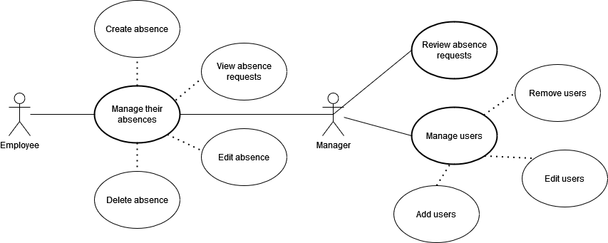
Use case Diagram

Slide 19
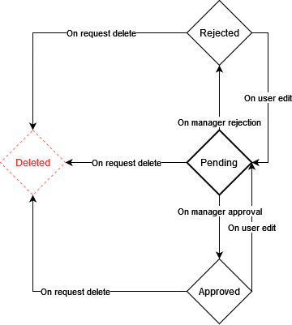
Absence life cycle

Slide 20

GOAL
People management web app
01
DATABASE
Our "client" has asked us to use PostgreSQL as the Database solution
You have to design a DB based on the previous requirements (use case diagram, problem description, feedback)
DATABASE
Design & Implement your DB
02
BACKEND
Make your data work
03
FRONTEND
The final product.
04
20

Slide 21

GOAL
People management web app
01
BACKEND
To be implemented with NodeJS & Express
Accepts HTTP request to interact with the business data
DATABASE
Design & implement your DB
02
BACKEND
Make your data work
03
FRONTEND
The final product
04
21

Slide 22


THE PROBLEM
People management web app
01
DATABASE
Design & Implement your DB
02
BACKEND
Make your data work
03
FRONTEND
The final product
04
22

Slide 23

THANK YOU
ANY QUESTIONS?

